Slide 1


A Novel Fusion-Based Deep Learning Model For Sentiment Analysis of COVID-19 Tweets
Aqeel Nasir Malik
23i-8013
Research Methodology

Slide 2
Agenda
Introduction
Background
Problem Statement/Research Gap:
Methodology:
Key Findings/Results
Discussion
Conclusion
Critique
Q&A

Slide 3
Introduction
Paper Title
A novel fusion-based deep learning model for sentiment analysis of COVID-19 tweets
Journal Name
Knowledge-Based Systems
Category & Medallion
W - Platinum
Author
Basiri, Mohammad Ehsan and Nemati, Shahla and Abdar, Moloud and Asadi, Somayeh and Acharrya, U Rajendra
Publisher
Elsevier
Impact Factor
8.139
Article History
First Submission: 7 June 2020
Revised Submission: 30 April 2021
Acceptance Date: 15 June 2021
Available Online: 25 June 2021

Slide 4








Background – Summary
The COVID-19 pandemic, a once-in-a-century event, has taken nearly 35 million lives and affected close to 150 million individuals globally, reshaping societies and economies profoundly.
The research investigates sentiment analysis of COVID-19 related tweets using a novel fusion-based deep learning model.
It aims to understand changing sentiments across different countries and correlate them with factors like the number of infected cases, recoveries, and deaths.
Utilizes data from Google Trends and Twitter to gauge public interest and sentiment regarding COVID-19 topics
The proposed fusion model combines deep learning and classical machine learning techniques to improve accuracy in sentiment classification, offering valuable insights for policymakers and health authorities
Google Trends: To analyze the interest of people in COVID-19 related topics over time Twitter Data: To analyze the sentiment expressed in tweets from eight countries

Slide 5
Background – Literature Review
Article - Conference Paper | Year | Type of Analysis | Analysis Description | Limitation
[1] | 2020 | Spatiotemporal Analysis | Analyzing the change of topics and mood during the epidemic from the perspective of time and space | Province Level Data Only. User Demographics like Age, Gender were not taken into consideration
[2] | 2020 | Topic Analysis | Analyze the public’s attention to events related to COVID-19 in China at the beginning of the COVID-19 | Study limited to First 52 Days of covid in China Only Narrow Data from 1 Source only Inlcudes age group between 18 - 41 only (Roughly 50% of population missing) Social Demographic Information missing
[3] | 2020 | Market Liquidity | Studies the impact of coronavirus outbreak on the microblogging content-based investors’ behavior and as results, on the cost-based market liquidity regarding the Australian Securities Exchange (ASX) | Study only analyzed the ASX Global aspect is missing
[4] | 2020 | Event Analysis | Tweets were studied to gauge the feelings of Indians towards the lockdown. Tweets were extracted using the two prominent hashtags used namely: #IndiaLockdown and #IndiafightsCorona from March 25th to March 28th 2020. | Study limited to indian region against two hashtags only based on 4 days data Only refect good or bad sentiments No correlation with economic or anyother factor
[5] | 2020 | Term Analysis | The study aims to answer three questions: a) Do controversial COVID-19 terms convey emotions beyond geographic description of origin? b) What are the linguistic features of tweets with these terms? c) Are neutral and controversial terms interchangeable for classification? | Very Limited keywords used to identify the sentiments Scalability would be a challenge since data against each key word is very huge is size

Slide 6
Background – Problem Statement
Existing studies on COVID-19 microblog analysis have focused on various aspects such as spatiotemporal analysis, topic analysis, market liquidity, event analysis, and term analysis.
However, there's a gap in comprehensive research addressing the sentiment intensity of Twitter users towards COVID-19 across multiple countries.
Previous studies often analyzed data from specific platforms like Weibo or Reddit, limiting the scope to particular regions or demographics.
This study aims to bridge the gap by investigating sentiment trends across eight countries over a six-month period.
More specifically the study showed the relationship between several infected cases and death due to COVID-19 and the change in the sentiment intensity of Twitter users

Slide 7
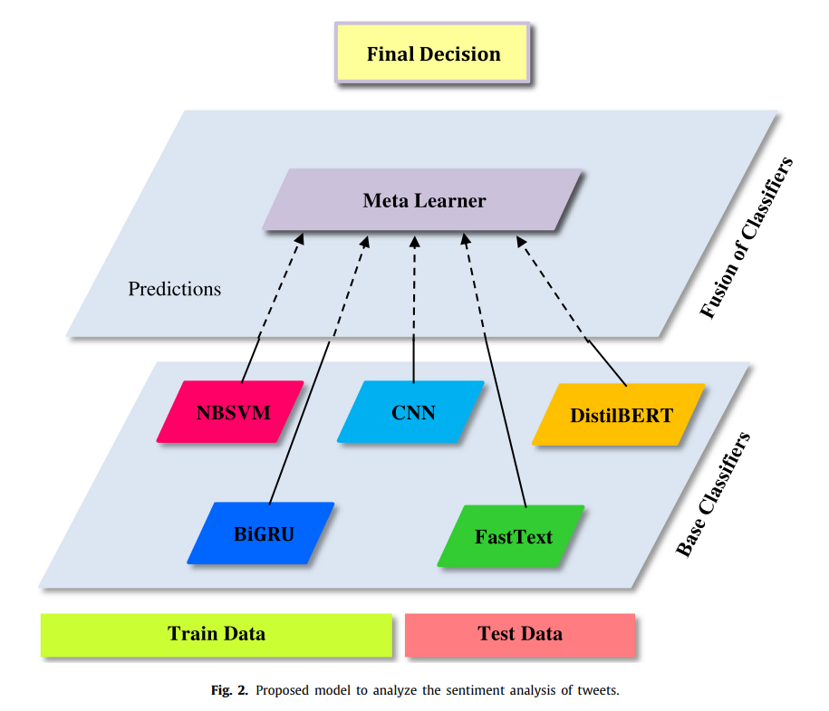
Methodology
Dataset Sources:
Google Trends – It was used to analyze the interest of people to obtain information about COVID-19 disease using Google searches of related keywords
Twitter – To analyze the sentiment expressed in tweets from eight countries. Keywords are as follows:
Base Classifiers:
NBSVM – word count features are replaced by Naïve Bayes log-count ratios
CNN – model consists of an embedding layer which is used for mapping vocabulary indices into an embedding space
BiGRU – The BiGRU enables the model to consider both the preceding and succeeding contexts
FastText – This model uses batch normalization layer to improve the training speed and performance of the model.
DistilBERT – This is proposed to reduce the size and improve the training speed of original bidirectional encoder representations from transformers (BERT) model
Corona | Coronavirus | COVID-19 | SARS-CoV-2
nCoV | SARS-CoV-2 | 2019-nCoV | COVID-2019
SARS-CoV | SARS-CoV2 | SARS-CoVs | MERS-CoV

Slide 8
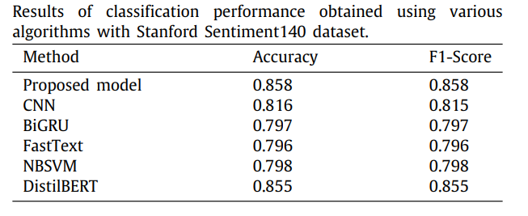
Results – Key Findings
Confusion Matrix used to get the accuracy and F1-Score of different Classifiers
Key Findings:
The proposed sentiment analysis model outperformed four other deep learning models and slightly surpassed the state-of-the-art DistilBERT model for text mining applications
It may be noted that the increase in positive sentiment correlates with the increase in the number of recoveries.
The most positive tweets belong to Iran, China, and Canada (80%, 65%, and 65%)
The most negative tweets belong to Iran, Italy, and Spain (80%, 75%, and 75%)
For English speaking countries, there is less fluctuations in the percent of tweets’ sentiments
The maximum negative sentiment values are seen either around the rise of new and active cases or the number of death charts
Significance:
Policy Making and Healthcare Management – Strategies can be devised to address concerns and improve public mood, especially during periods of rising cases or deaths
Global Comparison and Prediction – This analysis informs social scientists and healthcare agencies about public mood variations and aids in predicting how changes in COVID-19 metrics affect sentiment
Social Impact and Future Research – The study sheds light on COVID-19's societal impact, guiding future sentiment analysis in pandemics and aiding in devising strategies to counteract negative sentiments during health crise

Slide 9
Conclusion – Discussion
Analyzing the Finding:
It contributes to the growing body of research on sentiment analysis
It aligns with previous studies that have utilized social media data and highlights the importance of understanding public perceptions during health crises
Strengths:
Comprehensive analysis across eight countries
Novel fusion model for sentiment analysis
Provides valuable insights into correlation between sentiment and COVID-19 metrics
Weaknesses:
The Study include potential biases in the Twitter data and the reliance on English-language tweets
It overlooks the influence of global news and statistics on sentiment
Alternative interpretations
There is a strong correlation between public sentiments and COVID-19 metrics.
Cultural and societal factors may influence sentiment differently across countries
Potential avenues for future research
Refining the sentiment analysis model to account for nuances in language and cultural context
exploring the impact of interventions or policies on public sentiment during pandemics could provide valuable insights for policymakers
studies could also investigate the longitudinal trends of sentiment and its implications for mental health and well-being

Slide 10
Critique
The paper clearly defines the objectives (what) of the research, which involve understanding global sentiment toward COVID-19, proposes a fusion model (how) to analyze sentiment using Twitter and Google Trends data, and explains the rationale (why) behind the study, emphasizing the importance of sentiment analysis in informing public health strategies during the pandemic
While the evaluation demonstrates promising performance, questions remain about the generalizability of findings beyond Twitter users and the long-term impact of the pandemic on public sentiment.
The paper contributes valuable insights into global variations in sentiment towards COVID-19, emphasizing the importance of innovative approaches in sentiment analysis for informing public health interventions.

Slide 11
References
[1] Bangren Zhu, Xinqi Zheng, Haiyan Liu, Jiayang Li, Peipei Wang, Analysis of spatiotemporal characteristics of big data on social media sentiment with COVID-19 epidemic topics, Chaos Solitons Fractals 140 (2020) 110123
[2] Yuxin Zhao, Huilan Xu, Chinese public attention to COVID-19 epidemic: Based on social media, J. Med. Internet Res. 22 (5) (2020) e18825.
[3] Saleemi Jawad, COVID-19 outbreak, correlating the cost-based market liquidity risk to microblogging sentiment indicators, Nat. Account. Rev. 2 (3) (2020) 249–262.
[4] Barkur Gopalkrishna, Giridhar B. Kamath Vibha, Sentiment analysis of nationwide lockdown due to COVID 19 outbreak: Evidence from India, Asian J. Psychiatry 51 (2020) 102089.
[5] Long Chen, Hanjia Lyu, Tongyu Yang, Yu Wang, Jiebo Luo, In the eyes of the beholder: Sentiment and topic analyses on social media use of neutral and controversial terms for covid-19, 2020, arXiv preprint arXiv:2004.10225

Slide 12
THANK YOU

